Slide 1



SERVICE REGISTRY & DISCOVERY
#1
MICROSERVICES ARCHITECTURE

Slide 3
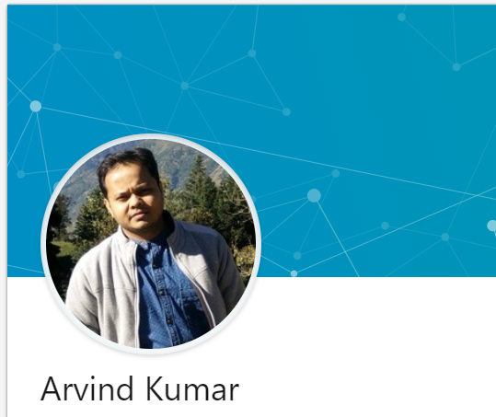
About me
Senior software developer
7+ years of experience
Polyglot programmer
Passion
Facebook – https://www.facebook.com/greenlearner
LinkedIn - https://www.linkedin.com/in/arvind-kumar-108a4b2b/

Slide 4
SERVICE REGISTRY & DISCOVERY
ARVIND
#2
Introduction
MICROSERVICES ARCHITECTURE

Slide 5
Introduction to service registry & discovery
Important for microservices architecture
Client Side service discovery
Server side servicer discovery

Slide 6
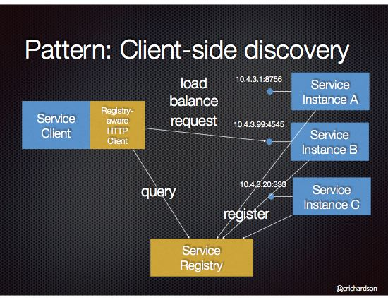
Client Side service discovery
Netflix Eureka

Slide 7
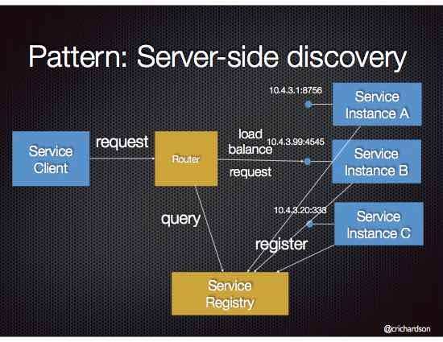
Server side service discovery
AWS Elastic Load Balancer (ELB)

Slide 8
Application design for demo
E
U
R
E
K
A
S
E
R
V
E
R
DoctorService
Eureka client
Doctor Portal
PatientService
Eureka client
DiseaseService
Eureka client

Slide 9

SERVICE REGISTRY & DISCOVERY
ARVIND
#3
Demo – spring boot + eureka Server
MICROSERVICES ARCHITECTURE

Slide 10
SERVICE REGISTRY & DISCOVERY
ARVIND
#4
Demo – spring boot + eureka CLIENT
MICROSERVICES ARCHITECTURE

Slide 11
SERVICE REGISTRY & DISCOVERY
ARVIND
#5
Demo – spring boot + eureka discovery CLIENT
MICROSERVICES ARCHITECTURE

Slide 12
Application design for demo
E
U
R
E
K
A
S
E
R
V
E
R
DoctorService
Eureka client
Doctor Portal
PatientService
Eureka client
DiseaseService
Eureka client

Slide 13
Introduction to service registry & discovery

Slide 14
Introduction to service registry & discovery

Slide 15
Introduction to service registry & discovery

Slide 16
Introduction to service registry & discovery

Slide 17
Introduction to service registry & discovery

Slide 18
Introduction to service registry & discovery

Slide 19
Introduction to service registry & discovery

